Slide 1




ECE477 Midterm Design Review: Team #15
Caleb Shinkle Software Lead
Brian Lu Systems Lead
Seth Deegan Team Lead
Nathan Huang Hardware Lead

Slide 2
Outline
Project Overview
Major Components
Block Diagram
Packaging Design
Electrical Schematic
PCB Layout
Prototyping Progress
Software Development Status
Project Timeline
Questions

Slide 3
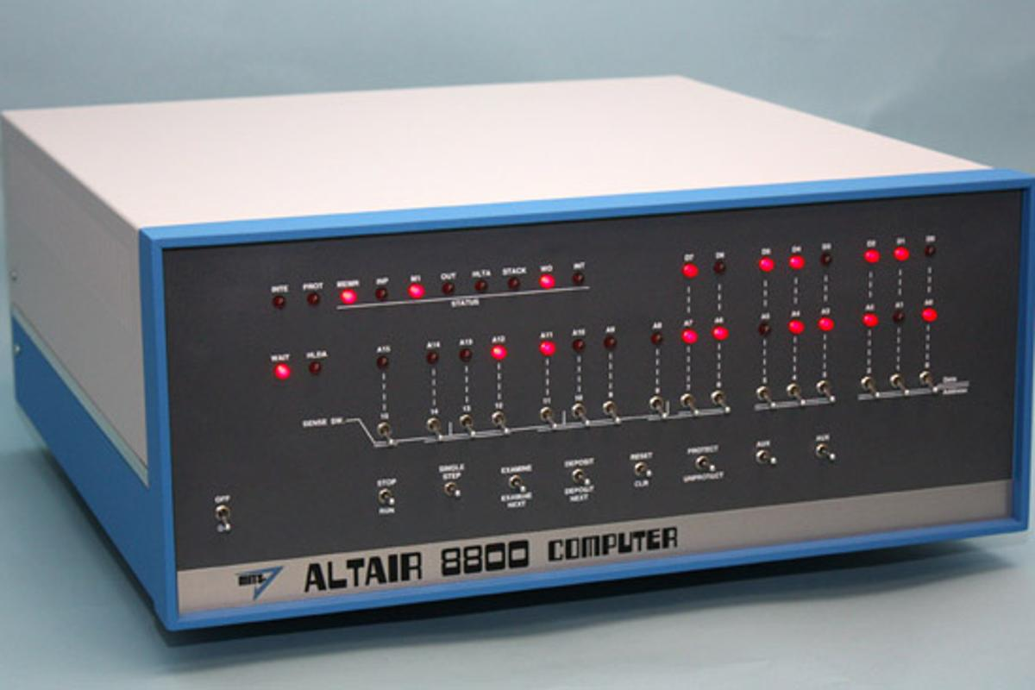
Project Overview
Alpha-Cassiopeiae
αCassiopeiae: a condensed clone of the Altair 8800
Switches/LEDs on front panel for user interaction
Instruction/Data input
Memory examination
Smaller and lower-power
Modern bus voltage (3.3V)
Original hardware emulated in software (Rust)
Able to run 8080 programs
Designed for hobbyists/collectors

Slide 4
PSDRs
(Hardware) Ability to support communication between CPU and RAM cards over a simplified S-100 inspired bus, using a backplane PCB with DDR4 DIMM edge connectors to connect bus signals between cards
(Hardware) Ability to interface the RP2350B microcontroller with I2C-based MCP23017 and MCP23008 I/O expanders to reduce GPIO pin usage, allowing support of all 44 bus signals and additional features.
(Hardware) Ability to provide a regulated power supply is fulfilled by the backplane board, which includes a 5V to 3.3V step-down power supply using a reference buck converter design.
(Software) Ability to emulate the Intel 8080 processor in software, written in Rust to decode and execute Intel 8080 instructions with accurate cycle timing and interrupt management. This emulator will be designed to emulate 8080 machine cycles, which respect concepts such as waiting for I/O operations.
(Software) Ability to manage parallel bus data exchange using Programmable IO (PIO) assembler routines, which are assembled and processed by the CPU, RAM, and front panel software. These routines must allow for multi-device control of the same data lines on the bus
Stretch
(Hardware) An ability for a UART card to implement the UART protocol, using I/O control lines (separate from memory control lines), and transmit/receive the information to/from an external UART port

Slide 5
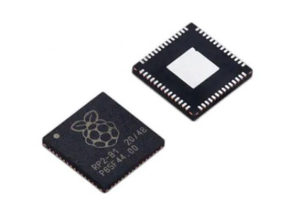
Major Components
Microcontroller
RP2350B (QFN80 Package)
150 MHz clock frequency
512 KB SRAM
48 GPIO pins
12 programmable I/O (PIO) state machines
2.7-5.5 V input voltage
Supports 16 MB external QSPI flash
2 UARTs
2 I2C controllers
2 SPI controllers

Slide 6
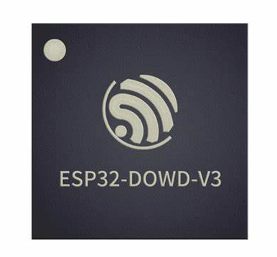
Major Components
Microcontroller Alternative
ESP32-DOWD-V3
240 MHz clock frequency
520 KB SRAM
34 GPIO pins
Not as many as RP2350, would require more expanders
2.3-3.6 V input voltage
3 UARTs
2 I2C interfaces
1 SPI interface
Chose RP2350 over ESP mainly due to GPIO requirements

Slide 7
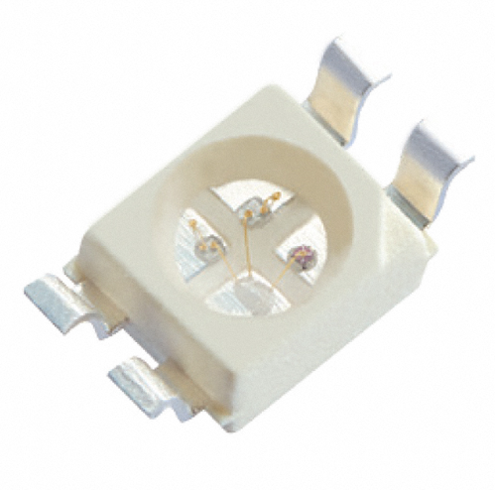
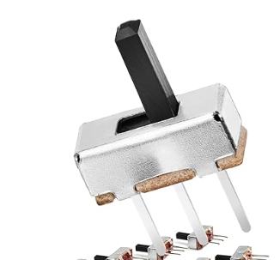
Major Components
Front Panel
The front panel for our system is a PCB that will contain a RP2350, as well as the switches and LEDs necessary for user interaction
LEDs: SunLED XZM2CRK45WT-9
Reverse-Mount LEDs (Red)
2.2V forward voltage
50mA forward current
Switches: Chanzon B09R3XLVVS
Through-Hole-Mount double-throw switches
Up to 50V, 500mA
There were lots of other switches and LEDs we could have chosen, just found ones that had the right voltage/current ratings and looked decent

Slide 8
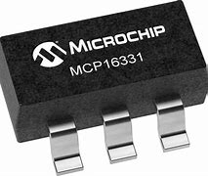
Major Components
Power Supply
Voltage Regulator: MCP16331
Input voltage range: 4.4-50 V
Output voltage range: 2-24 V
Adjustable with external resistors
Up to 1.2 A output current
Up to 96% efficiency, 2% output voltage accuracy
Will use wall adapter to step down 120V AC to 5V DC
Then use circuit with this to step from 5V DC to 3.3V DC

Slide 9
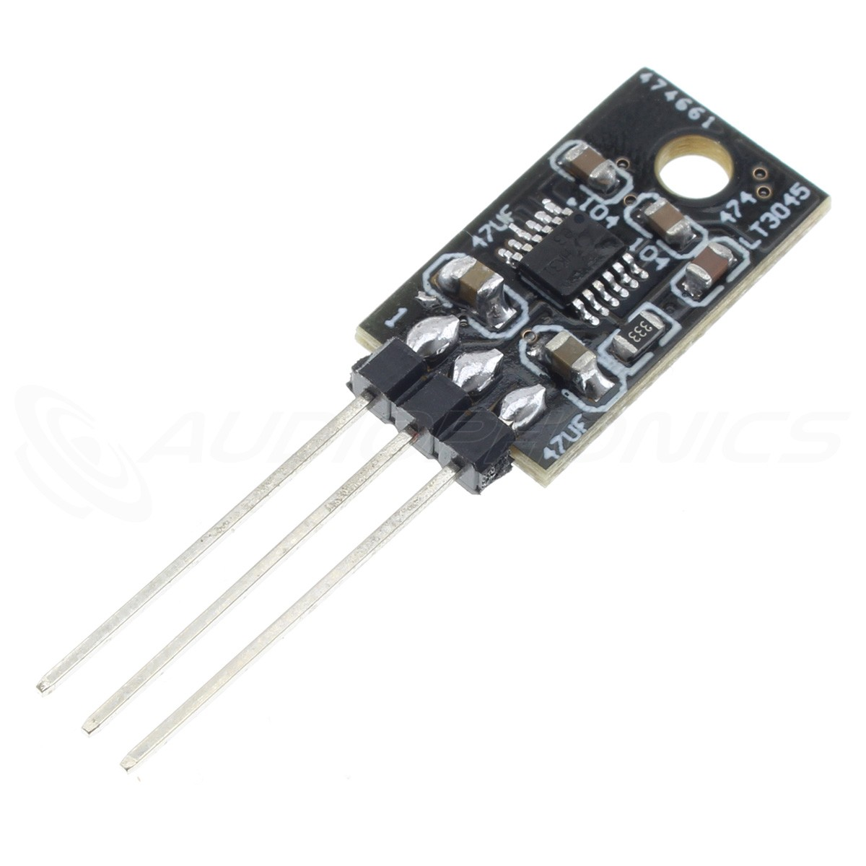
Major Components
Power Supply alternative
Voltage Regulator: LT3045
Input voltage range: 1.8-20 V
Output voltage range: 0-15 V
Only up to 0.5 A output current
Thought we might need more current since we have several microcontrollers, so we went with the MCP 16331

Slide 10
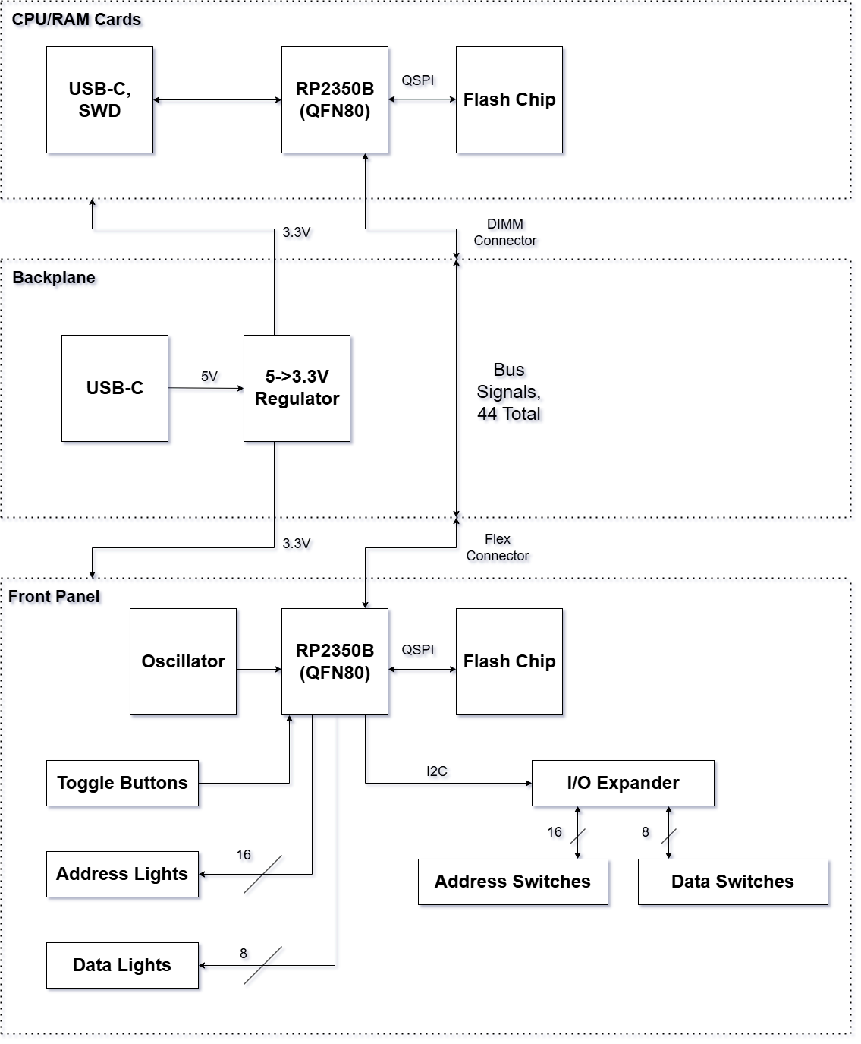
Block Diagram
CPU/RAM cards run CPU/RAM emulators respectively
Bus signals controlled by PIO on all RP2350Bs
Toggle buttons include deposit, examine memory, and clock single-step switches, among others

Slide 11
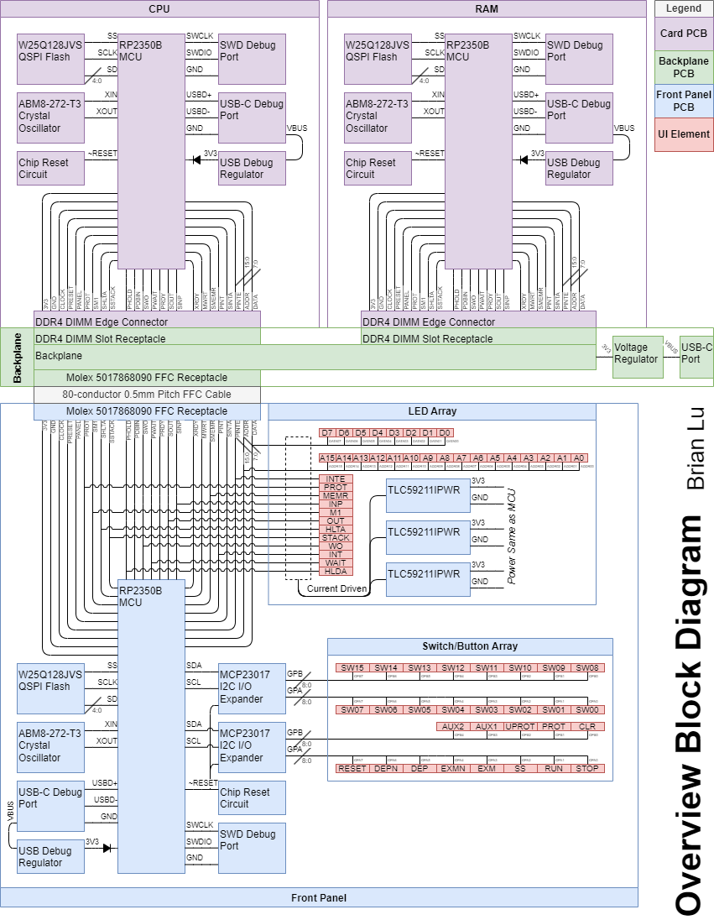
BLOCK DIagram
CARD/BACKPLANE DETAIL VIEW

Slide 12
BLOCK DIAGRAM
PANEL/BACKPLANE DETAIL VIEW

Slide 13
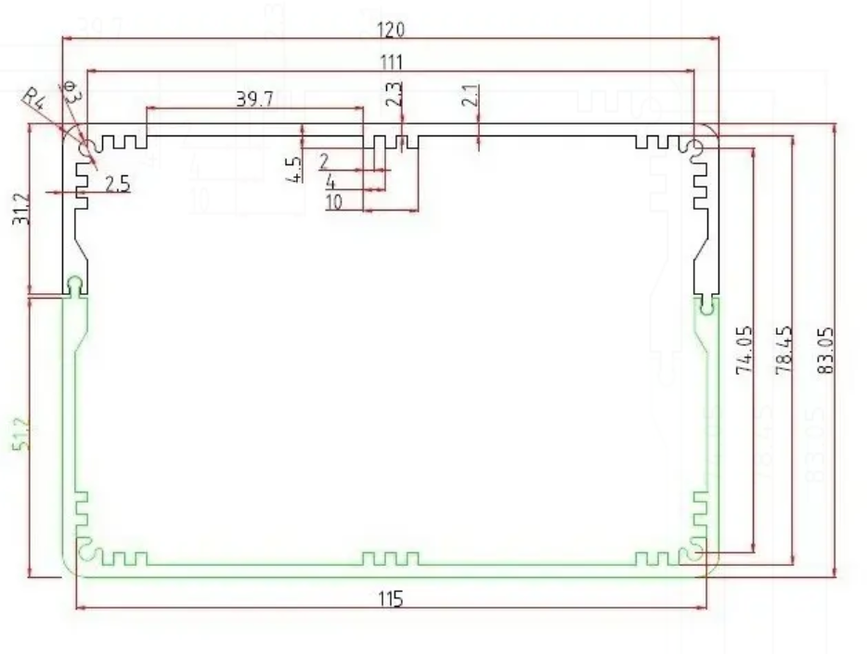
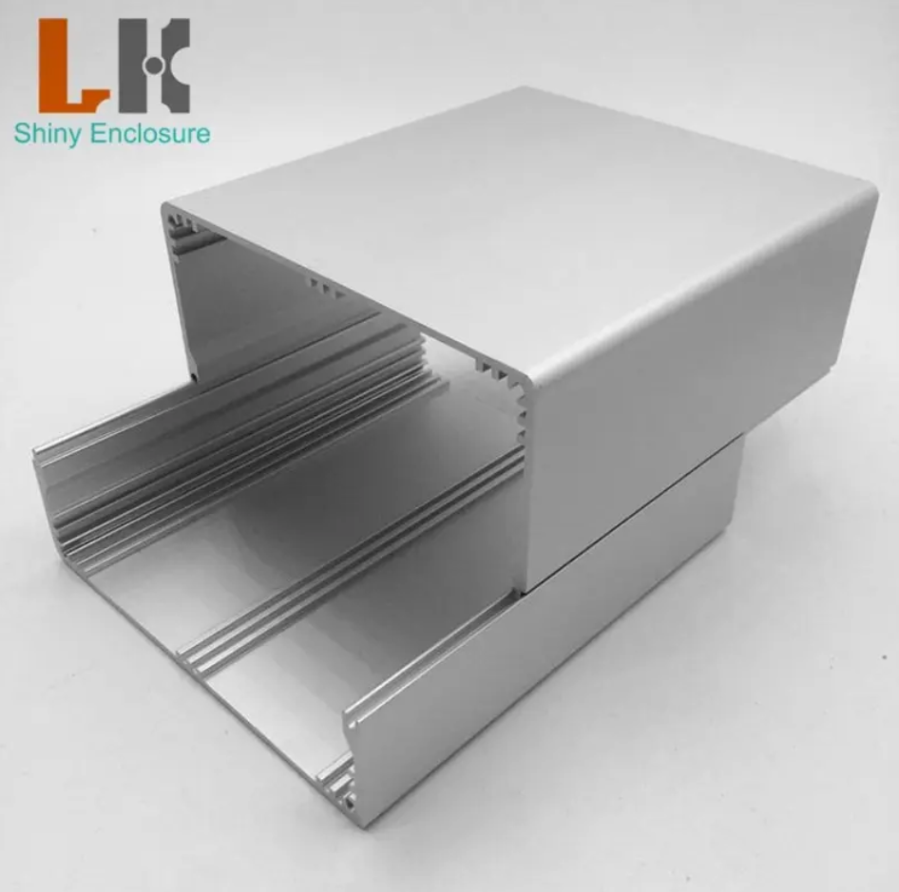
Packaging Design
Extruded ENCLOSURE

Slide 14
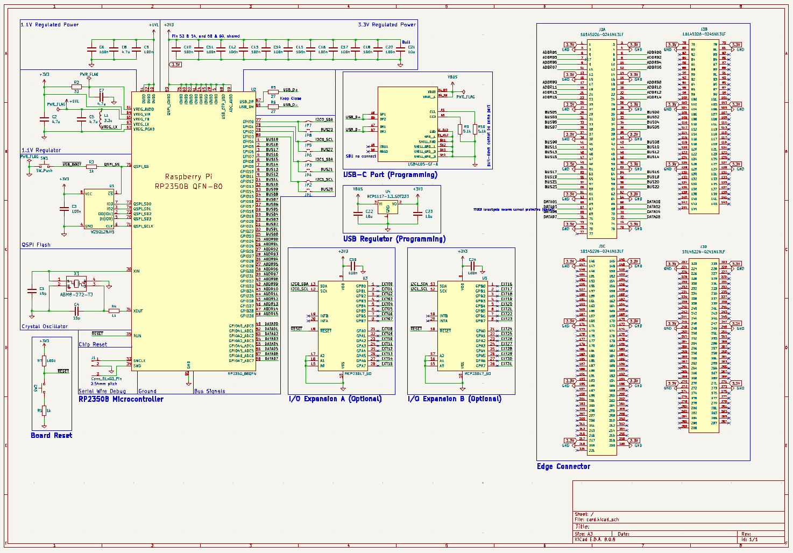
ELECTRICAL SCHEMATIC
Card

Slide 15
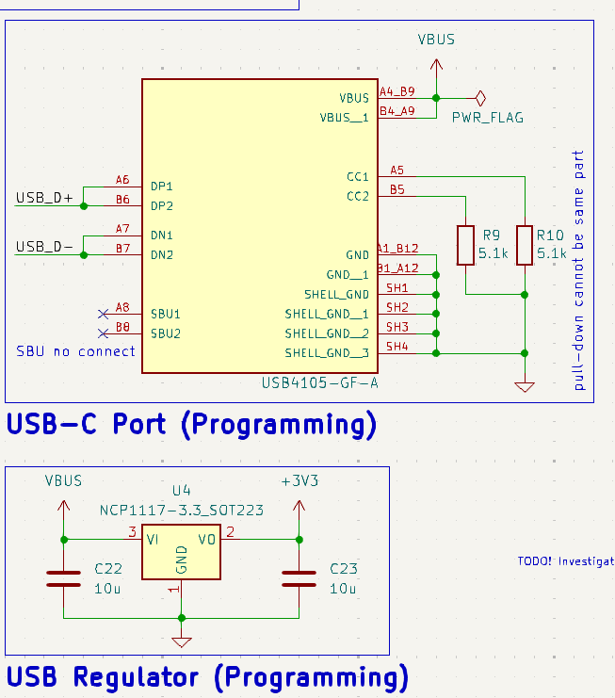
ELECTRICAL SCHEMATIC
Card – USB-C in

Slide 16
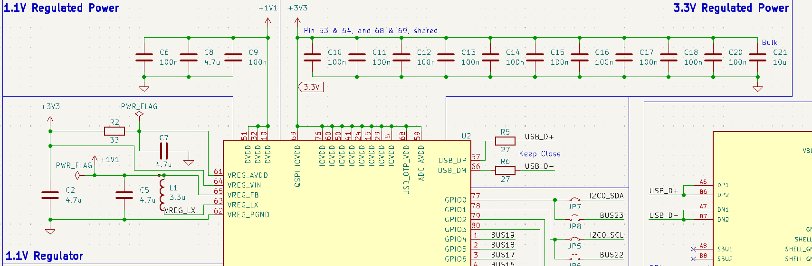
ELECTRICAL SCHEMATIC
Card – POWER Regulation

Slide 17
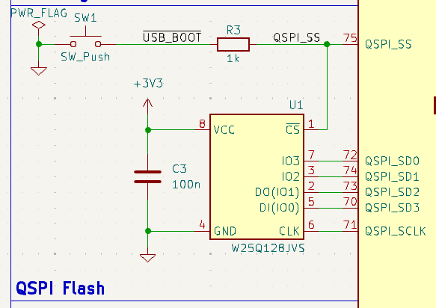
QSPI FLASH MEmORY

Slide 18
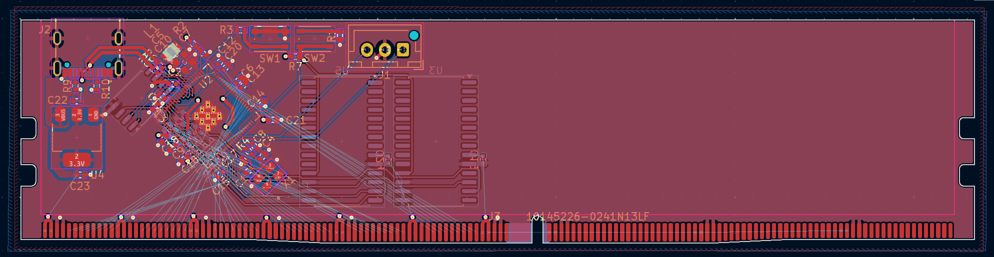
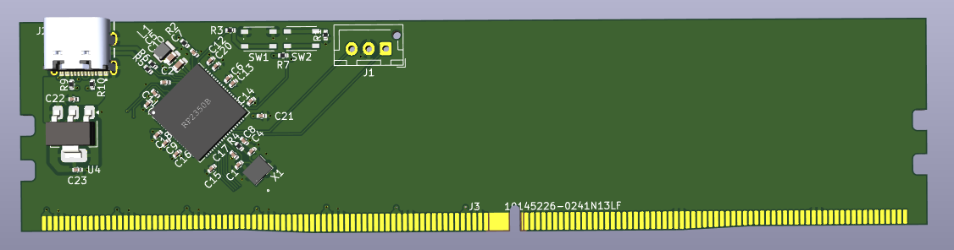
Card
Full View

Slide 19
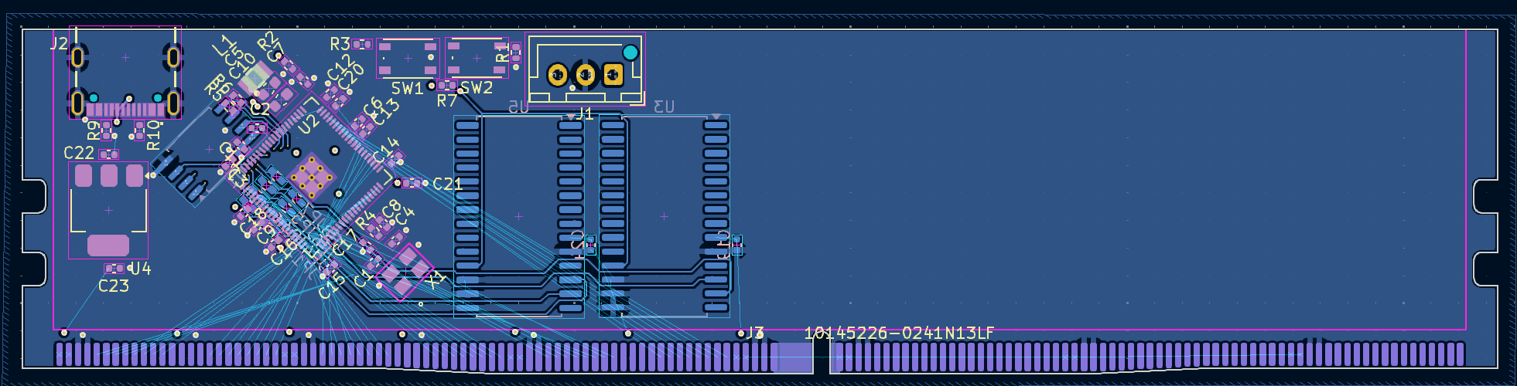
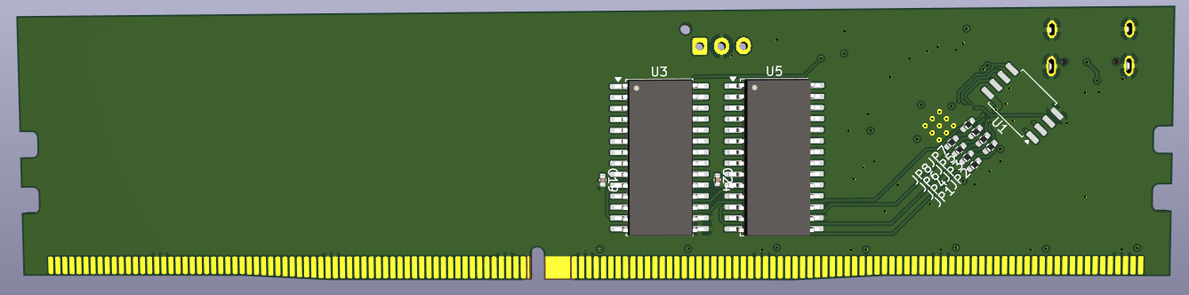
CARD
REAR VIEW

Slide 20
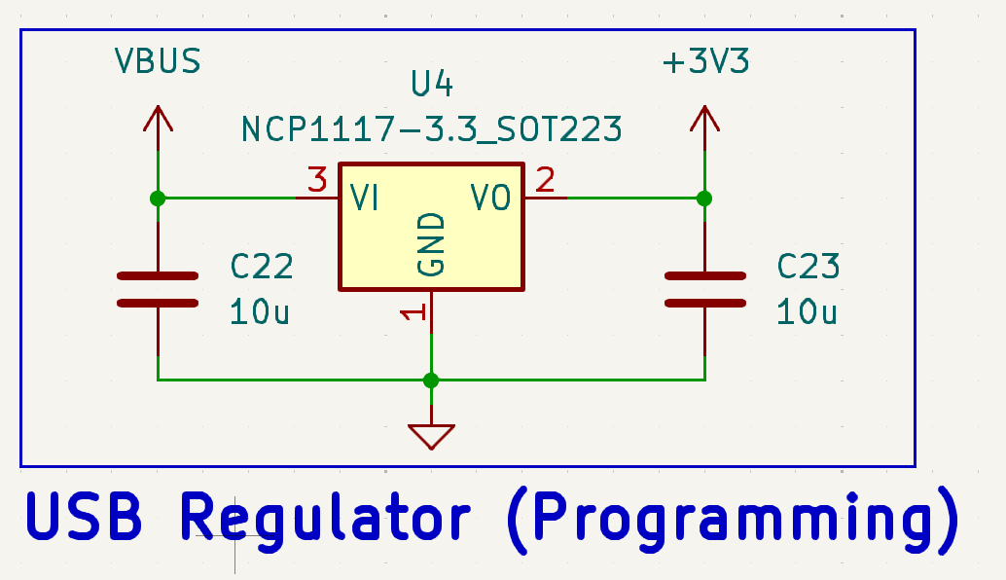
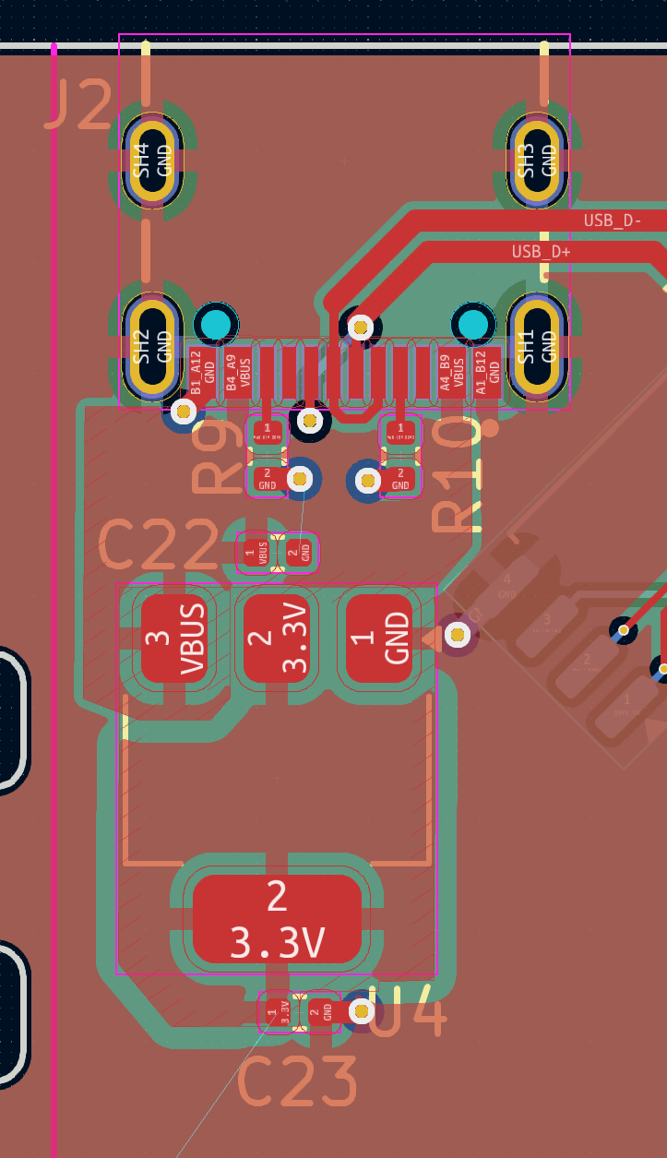
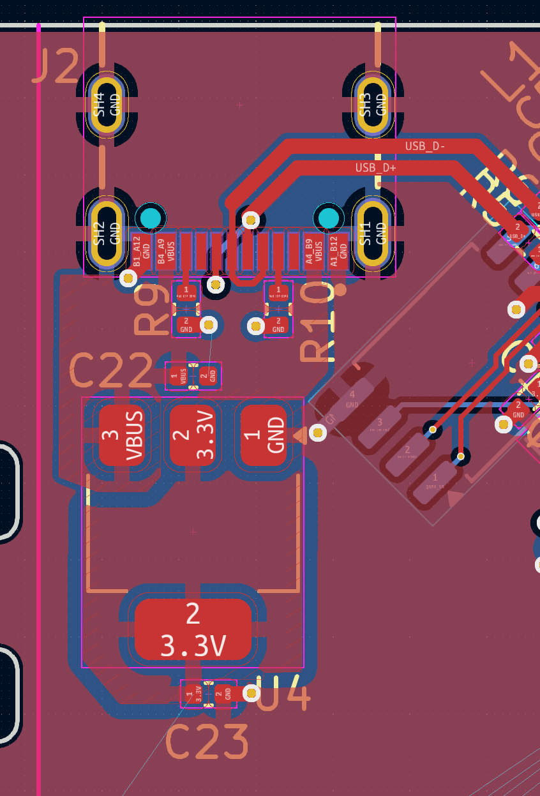
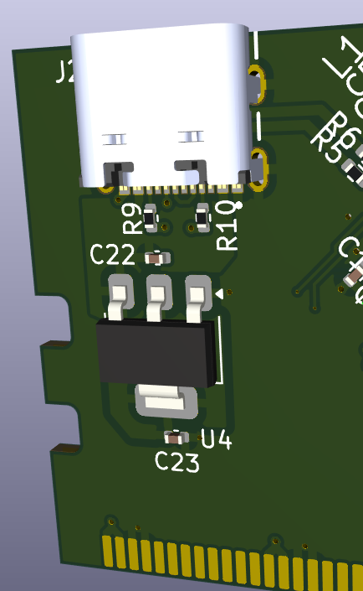
Card
USB-C

Slide 21
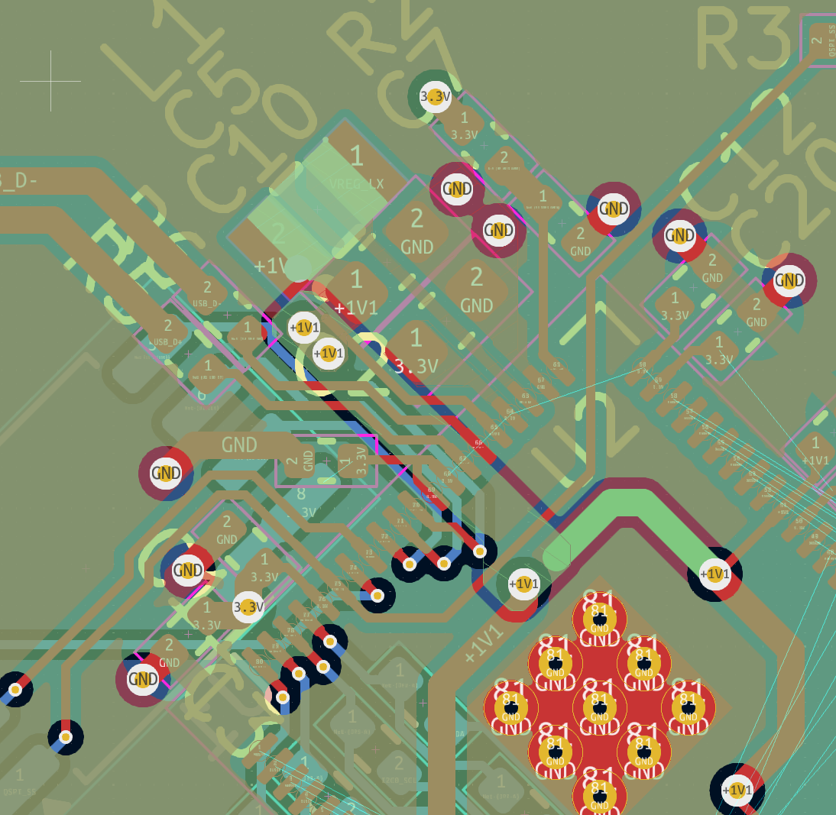
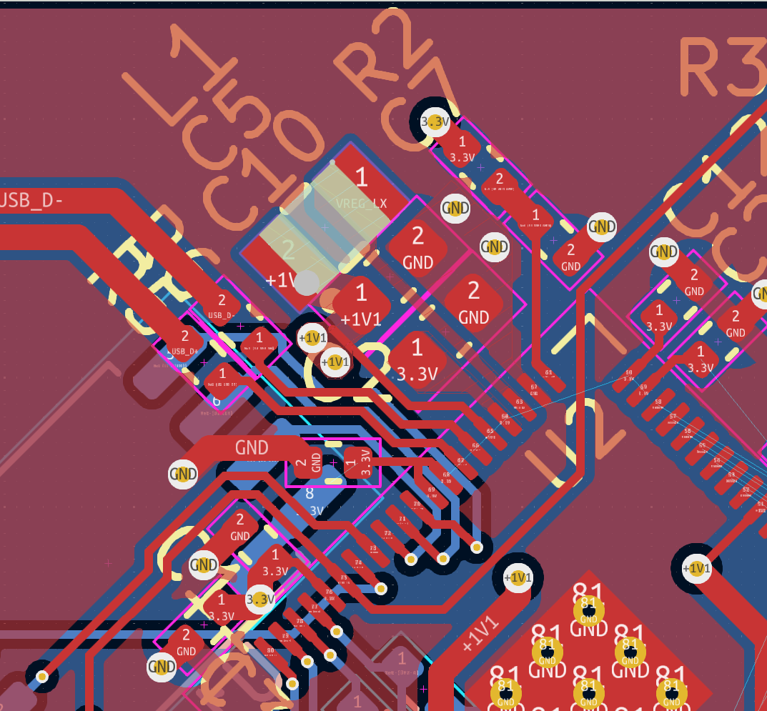
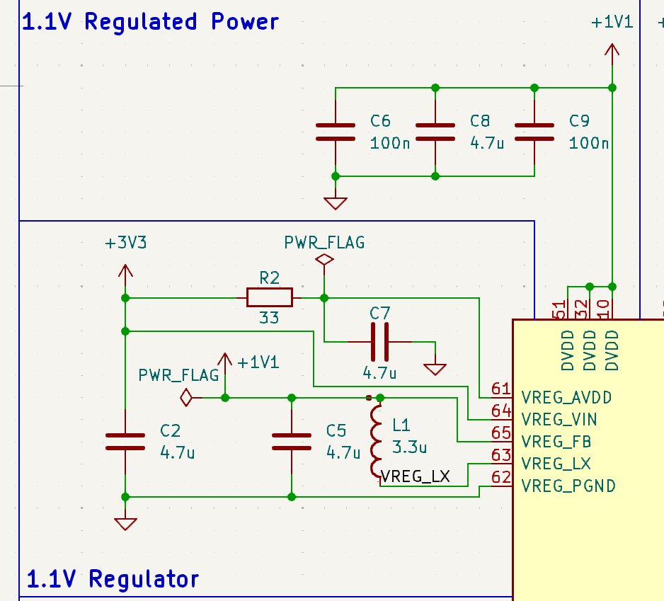
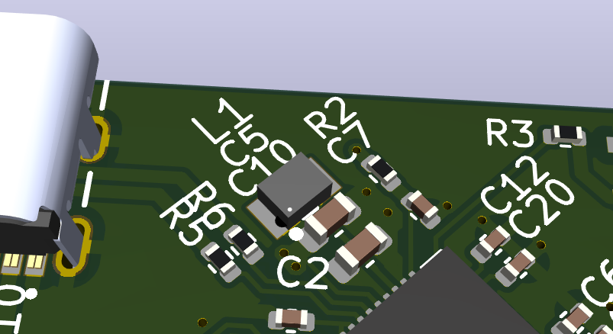
Card
Regulation

Slide 22
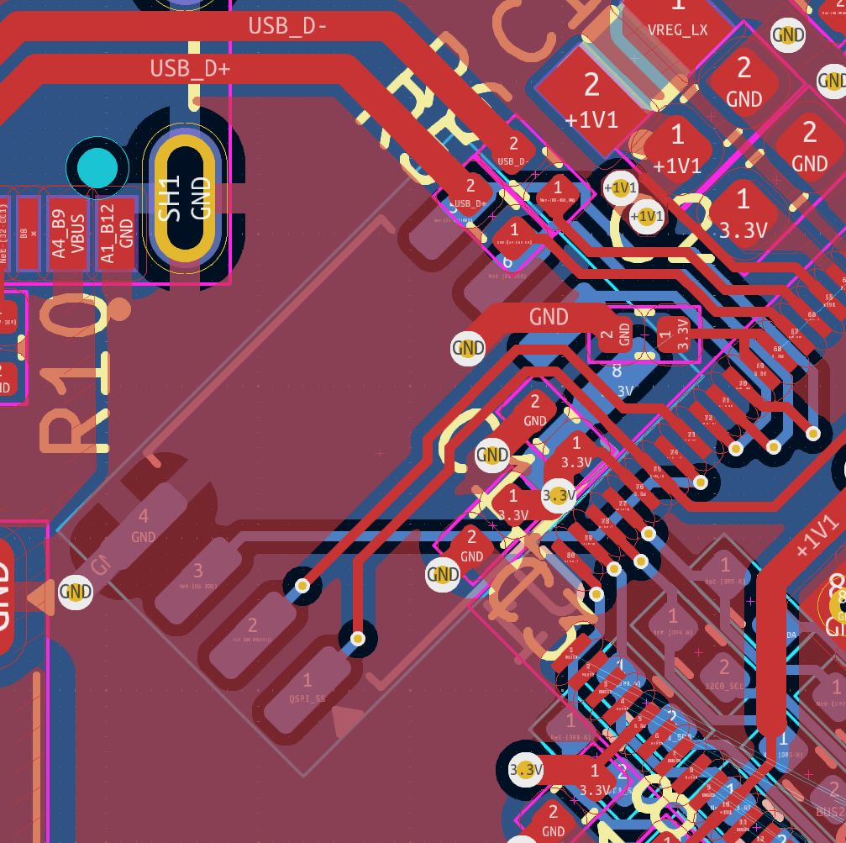
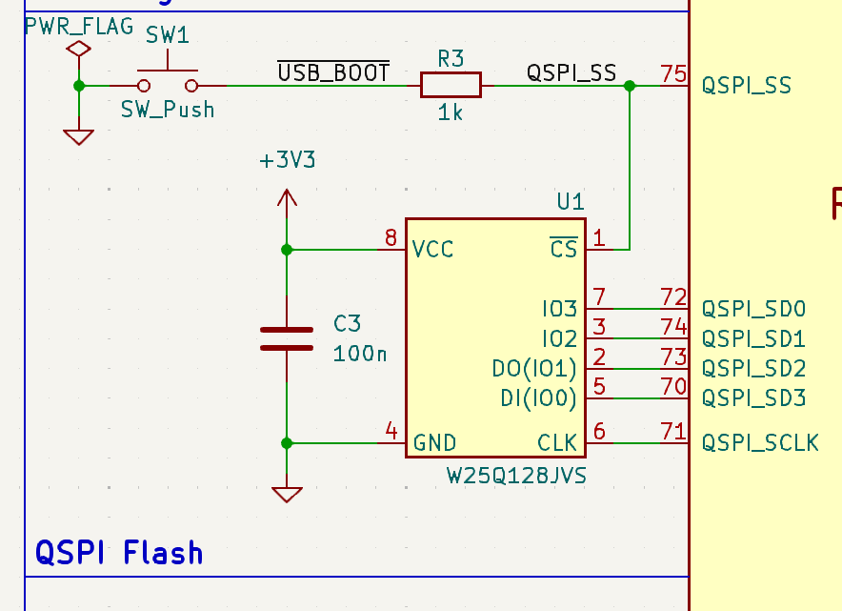
Card
MEmory

Slide 23
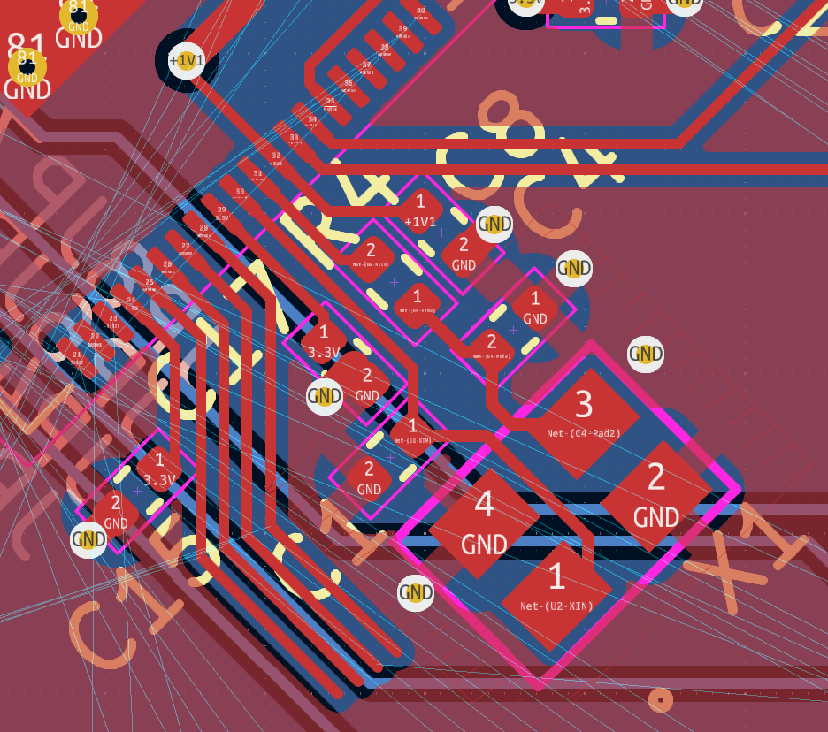
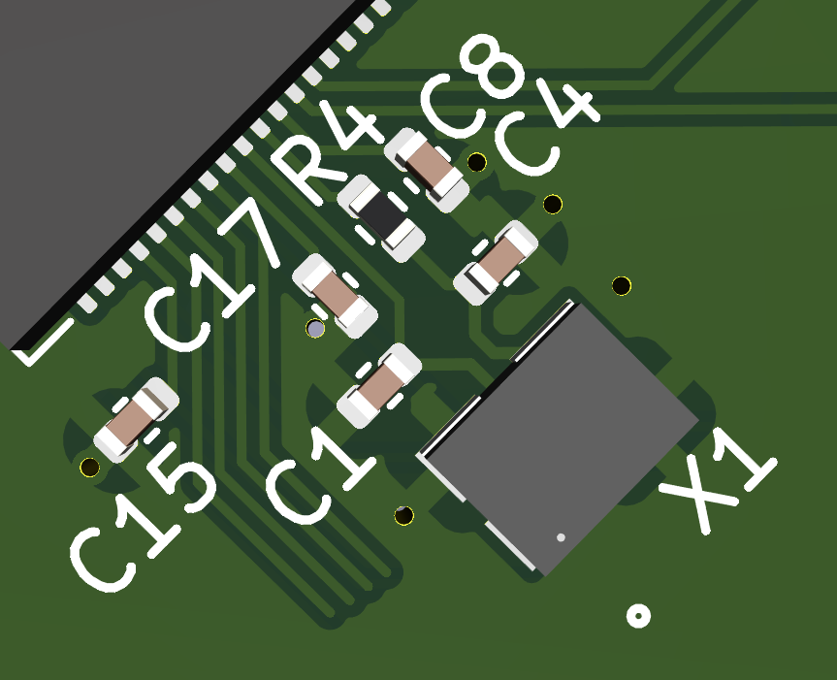
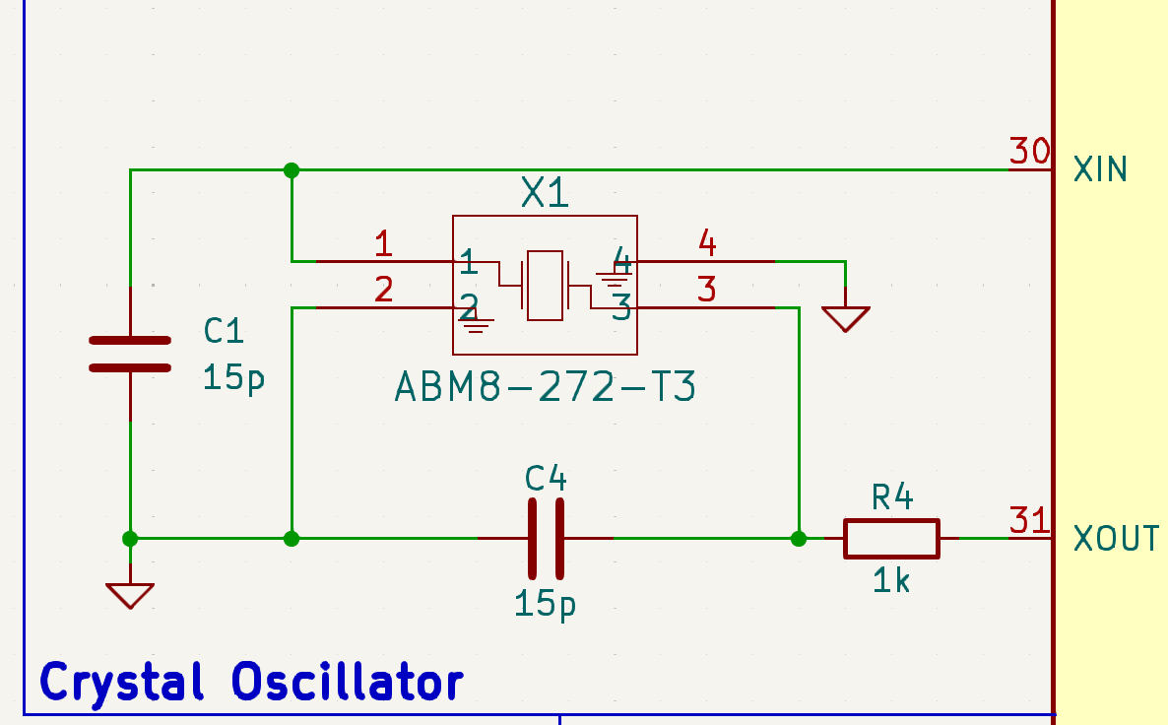
Card
Oscilator

Slide 24
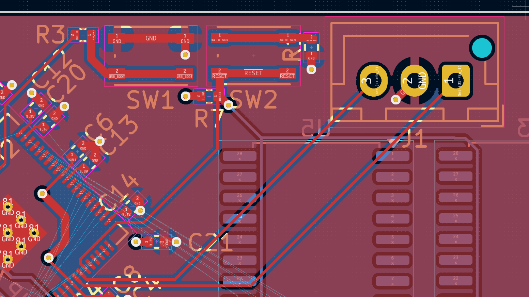
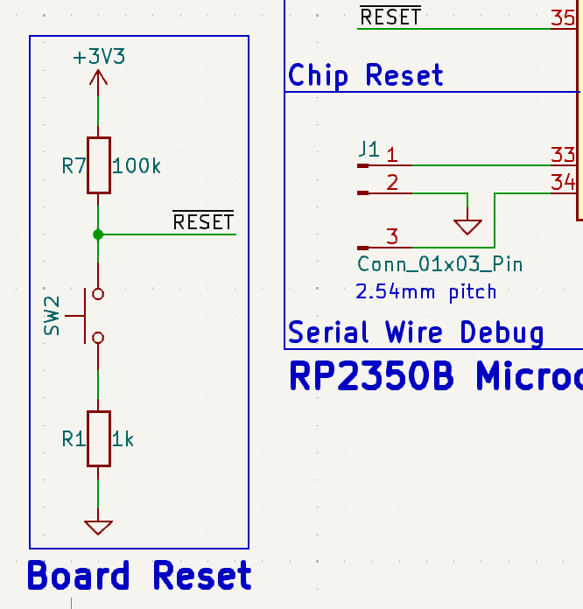
Card
Debug, ReSet

Slide 25
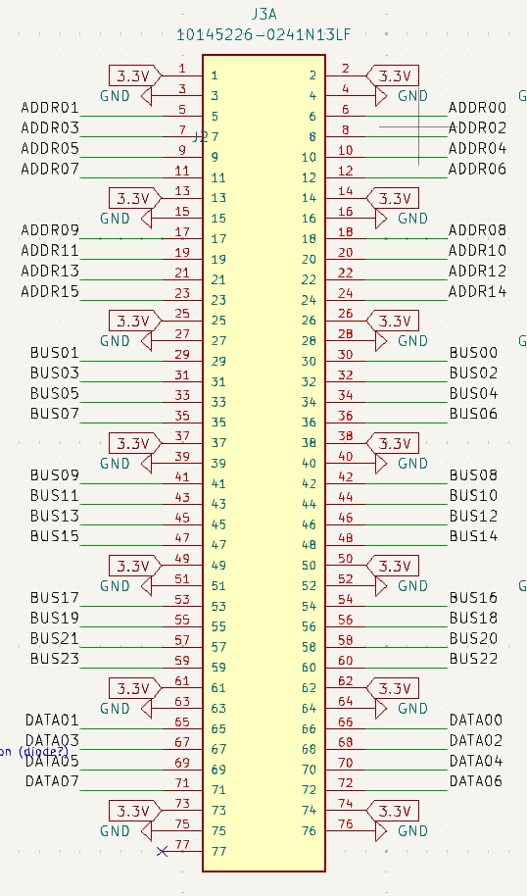
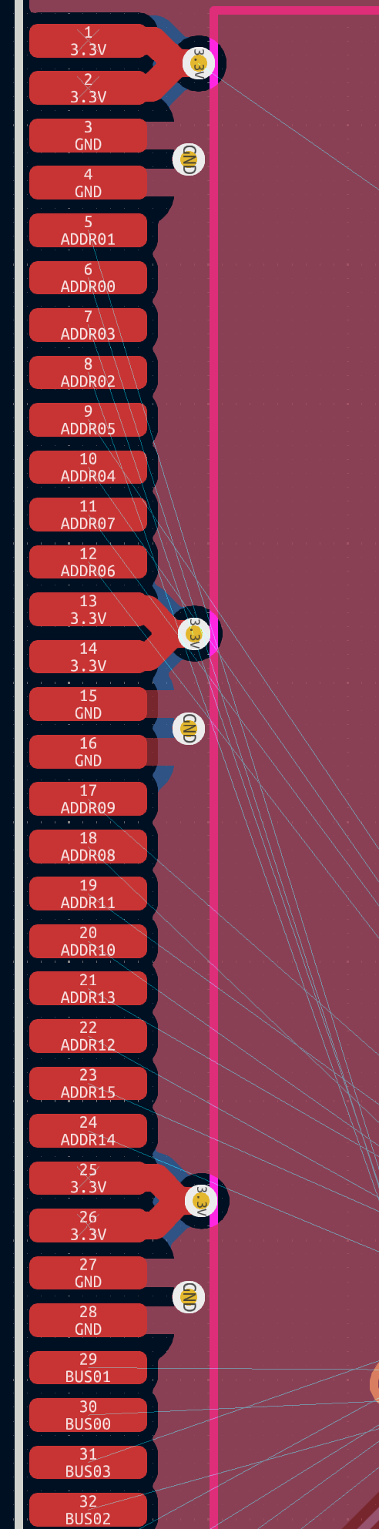
Card
Bus Layout
In Progress
Working backwards, PCB layout dictates final pin permutation

Slide 26
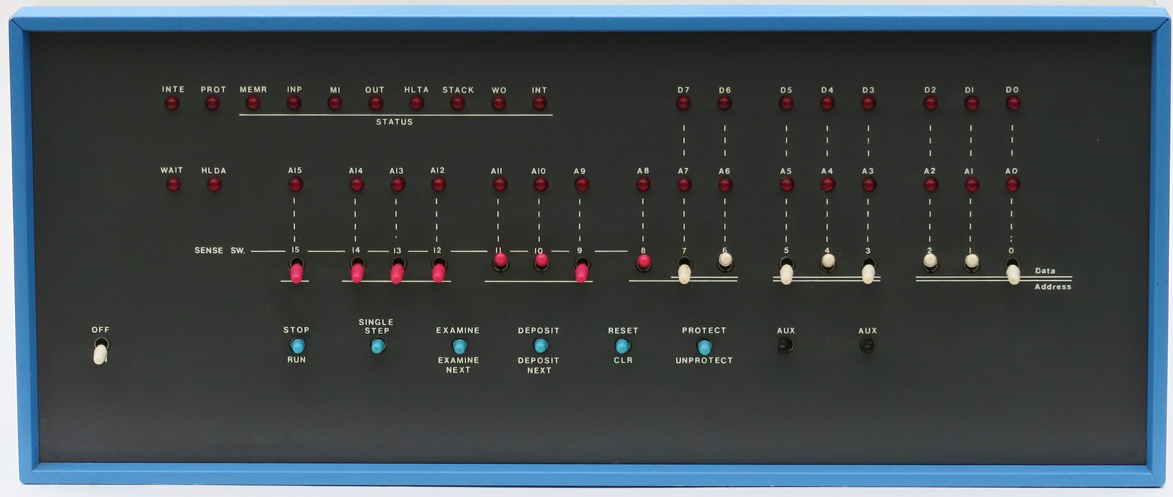
Front Panel
Old Design
Taken from: https://upload.wikimedia.org/wikipedia/commons/b/b2/MITS_Altair_8800_Front_Panel.jpg

Slide 27
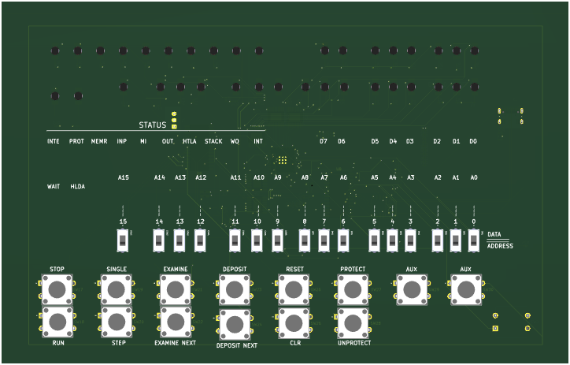
Electrical Schematic
3D-View: FRONT

Slide 28
Electrical Schematic
3D-View: BACK

Slide 29
Electrical Schematic
3D-View: Card

Slide 30
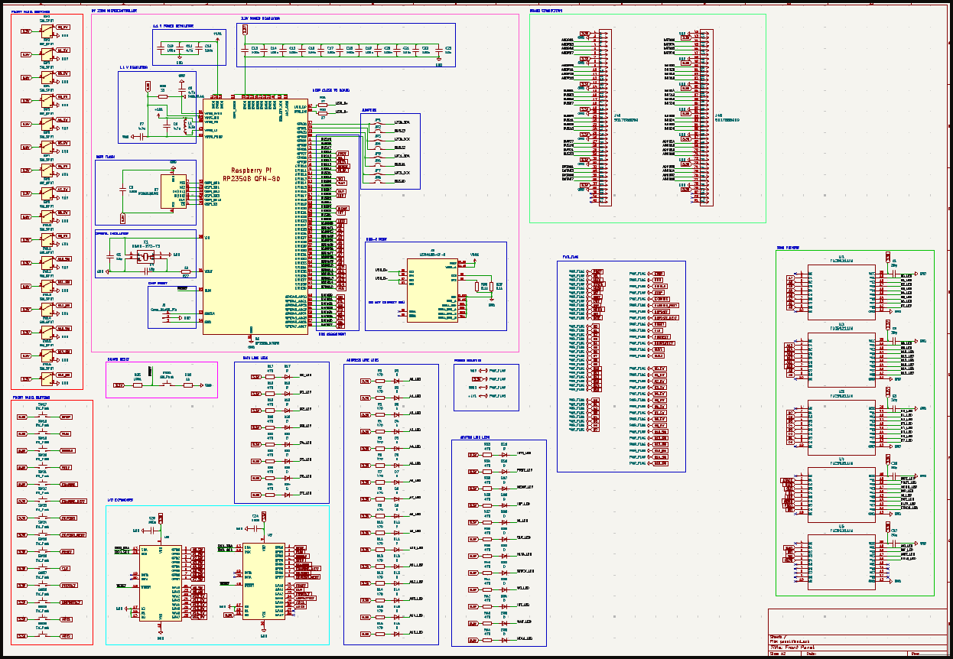
Front Panel
Full view

Slide 31
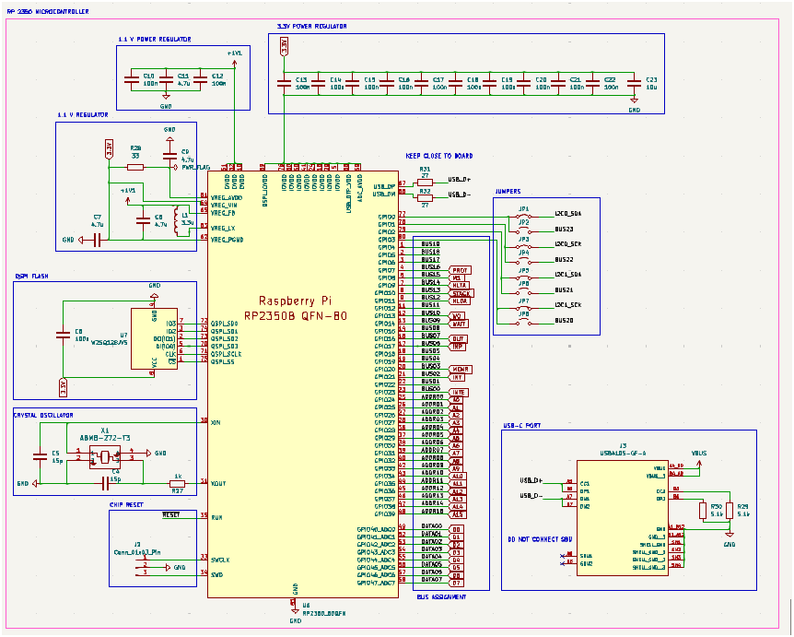
Front Panel
Microcontroller (1)
Inspired by Card Schematic
Debugging and Power Regulation
Slight Modifications to Addressing

Slide 32
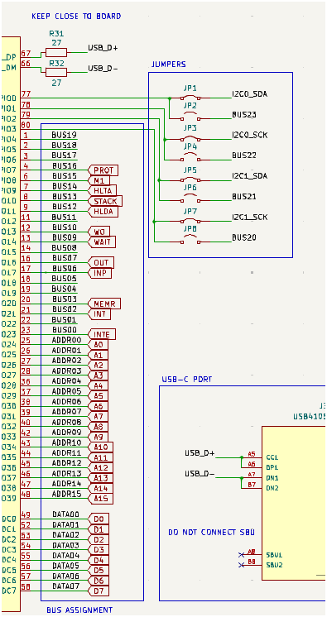
Front Panel
Microcontroller (2)
New Jumper Lines
Two I2C Channels
Remapping for Status Symbols

Slide 33
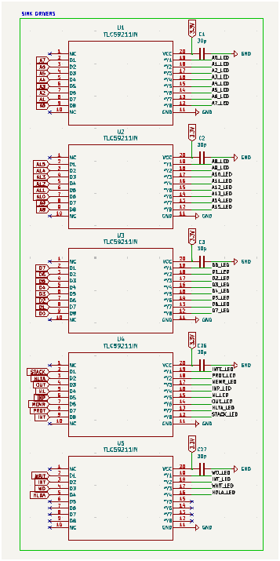
Front Panel
Sink drivers
5 TLC59211IN Sink Drivers
High output current
3-3.6 V Range
PW0020A SMD

Slide 34
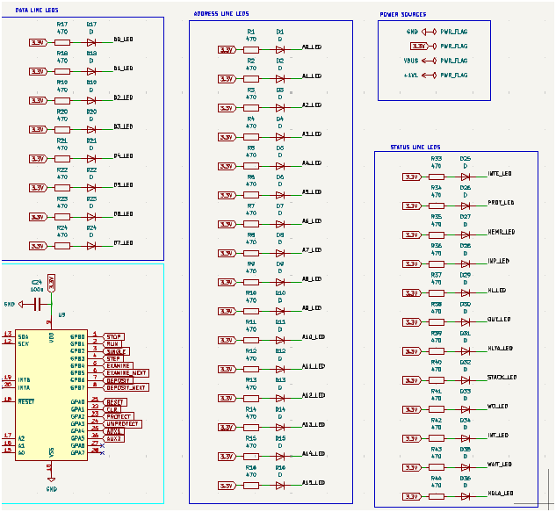
Front Panel
LED ARRAY
16 Address LEDs
8 Data LEDs
12 Status LEDs

Slide 35
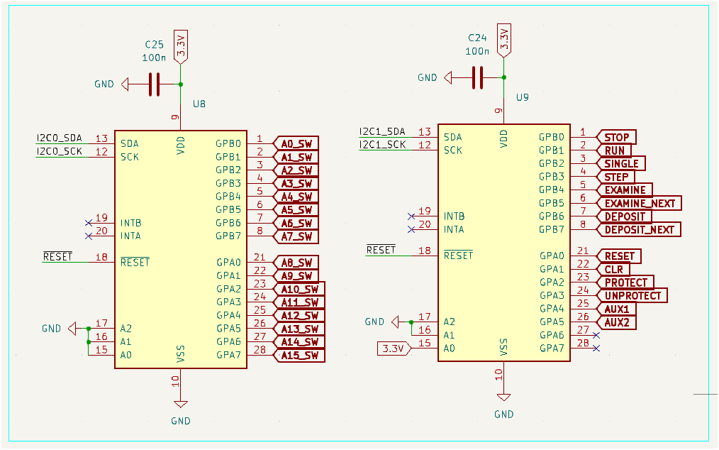
Front Panel
I/O Expansion
2 MCP23017 I/O Expanders
Offsets of 32 and 33
Connected to user inputs

Slide 36
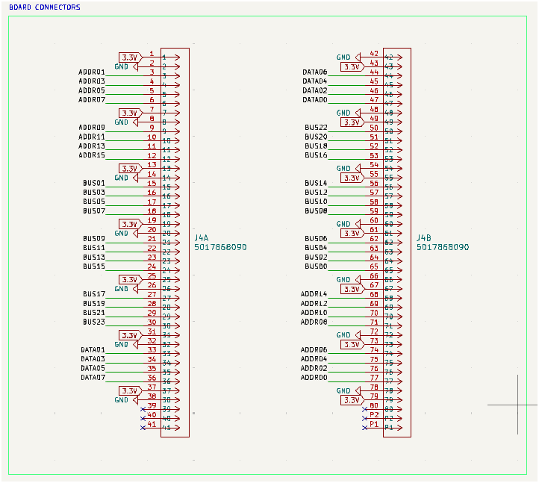
Front Panel
Board Connectors
Flat Flex Connectors
Staggered Power and Ground Lines
Enough Signals to carry S-100 Bus

Slide 37
Front Panel
Reset Line
Local Net
Hard Reset on I/O Expanders and RP2350.
Active Low

Slide 38
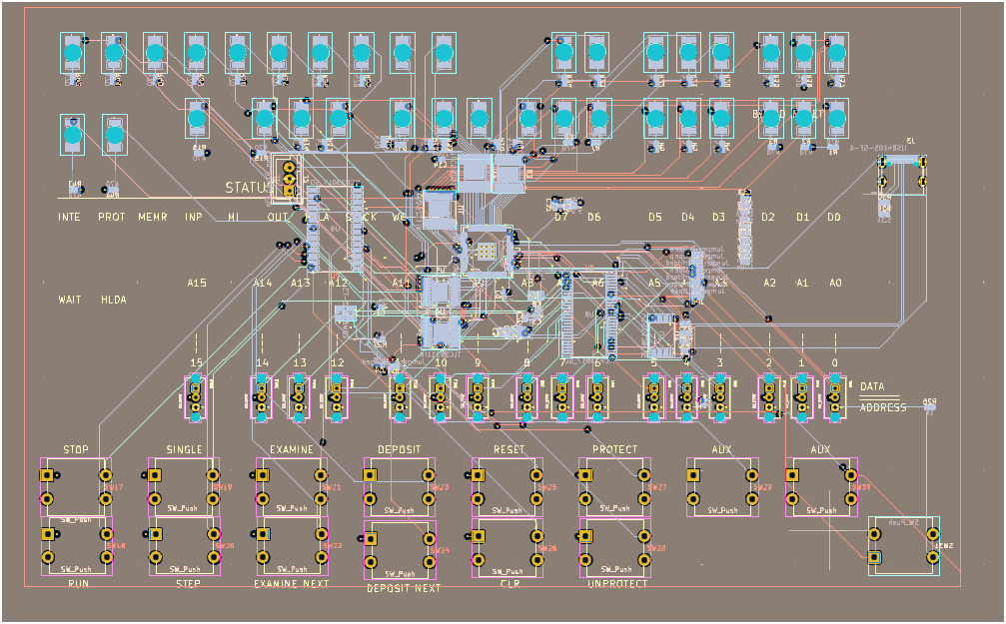
Front Panel
PCB LAYOUT

Slide 39
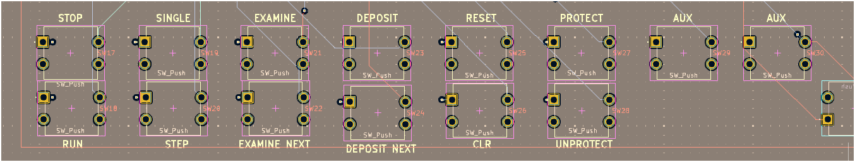
Front Panel
SWITCHES

Slide 40
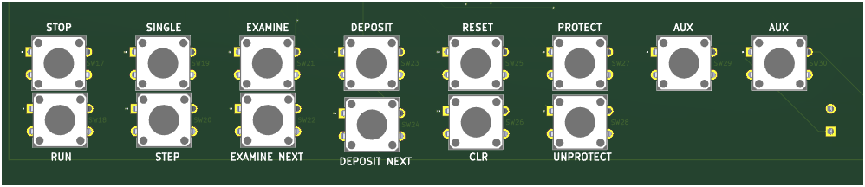
Front Panel
SWITCHES

Slide 41
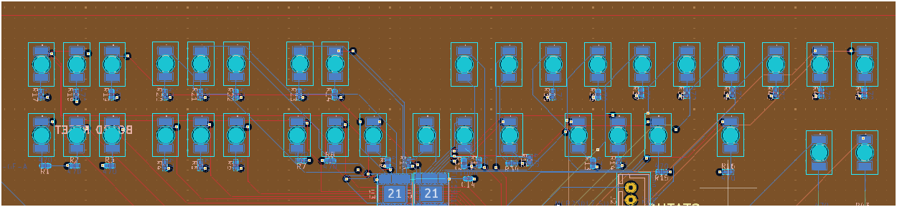
Front Panel
Status, ADDRESS, DATA LEDS (1)

Slide 42
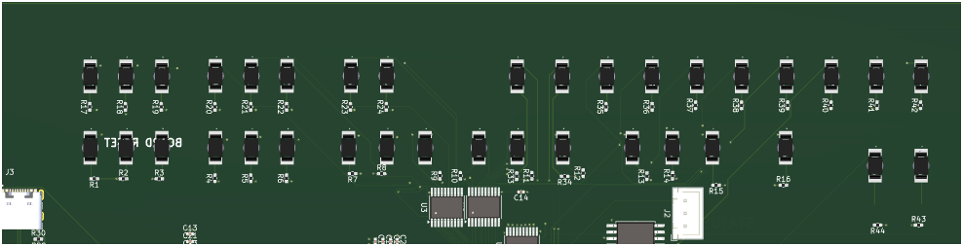
Front Panel
Status, ADDRESS, DATA LEDS (2)

Slide 43

Front Panel
Sink Drivers, microcontroller
Sink Drivers held close to Micro
Easier access to traces

Slide 44

Front Panel
Sink Drivers, microcontroller (2)
Layout needs optimization
Complete before submission

Slide 45


Front Panel
I/O Expanders
Same concept for Micro
I/O Lines close to inputs

Slide 46
Front Panel
I/O Expanders (2)

Slide 47

Back Plane
Full view

Slide 48

Back plane
Dimm slot

Slide 49

Back Plane
Power

Slide 50

Back plane
Layout

Slide 51

Back Plane
Power Layout

Slide 52

Back Plane
3d

Slide 53

Prototyping Progress
Front Panel Prototype
Switches and LEDs work as intended
Switches and LEDs for addresses/data follow desired behavior
Need to finish connecting to GPIO of micro running the front panel software
Any additional behavior changes we need will be implemented/debugged in software

Slide 54
Prototyping Progress
Backplane Prototype
2 RP2350B Stamp XL Boards
Direct connections of bus signals just like our eventual backplane board
Connected to breadboard to test communication between softwares (CPU emulator, RAM emulator, etc.)
2 Pico 2 Boards
Connected to bus signals for debugging with rs-probe
Allows testing of tram (bus control package) and other software
Doubles as test harness for our system

Slide 55


Prototyping Progress
Backplane Prototype
No Bus Signals Connected
Bus Signals Connected

Slide 56

Software Architecture

Slide 57
SoftWare learnings
It takes a lot to figure out how to emulate a full computer using newer technology!
How to program in Rust
What is async Rust
How Rust project structure works
How to program embedded devices and specifically the RP2350 with Rust
How Programmable I/O (PIO) works
8080 bus signals
8080 ISA
8080 emulator implementation
How the 8080 bus timing works
Types of bus operations we need to support

Slide 58

Software Specifications
Runner: CPU Emulation Software
Will run on the CPU card's RP2350B
Emulates the original Intel 8080 processor
Needs to drive bus signals through tram (our bus control package) specifying machine cycles (reads/writes)
As instructions need to access memory, machine cycles will be executed
Gives addresses/data to tram to put on bus
Goal is to implement functionality of all Intel 8080 instructions

Slide 59

Software Specifications
Recall: RAM Emulation Software
Will run on the memory card's RP2350B
Needs to listen to bus signals through tram specifying machine cycles (reads/writes)
Calls local read()/write() functions to retrieve/store values from stack-allocated array
Sends signals back to tram to put on bus

Slide 60

Software Specifications
Interchange: Front Panel Software
Will run on the front panel's RP2350B
Needs to drive LEDs on front panel and poll I2C lines/GPIO pins to detect changes on switches
Will also go through tram to access the bus when necessary (examining memory, etc.)

Slide 61
Overall Software operation
CPU emulator tells tram to execute instruction
Tram takes over machine cycle operation (reading/writing memory if needed)
Each machine cycle has different time steps, which tram will moderate
CPU emulator waits for tram to respond
Machine cycle fetches or writes one byte
If 3 bytes of data needed for a single instruction, it will take 3 machine cycles to complete
Sequence: Instruction Decode (runner) -> Machine Cycle (tram) -> Individual Timesteps (tram) -> Await response from memory (recall) -> return data to runner -> control given back to runner
Multiple layers of abstraction to work with

Slide 62
Bus architecture
Bus states
Tram is responsible for moderating bus state
When Running/Always:
CPU/MEM Read
CPU/MEM Write
Front/MEM Read
When in single step:
FRONT/MEM Write
UART will have its own states, stretch goal so we will figure that out if we get to it

Slide 63

Bus architecture
Bus Signal Table

Slide 64

Bus architecture
READ

Slide 65

Bus architecture
Write

Slide 66
Machine operation
Clock always running
Single step just triggers a flip flop to have the pc attach to the main clock.
Examine sends a jmp instruction (jmp, upper, lower)
Flip On switch (deliver power to all PCBs, microcontrollers start, set front panel = stop, CPU pc = 0)
Program first instruction
First byte
You’re already in data mode. Flip the switches to change the data line. Lights do not change
Hit deposit. Data lights should change to switch values.
Second byte
Flip switches to change data line
Hit deposit NEXT. Address lights flip to mem address 1, data line reflects switches.
X byte …
Examine byte
Flip switches to address you want to examine
Hit Examine. Data lights should change.
Running
Hit Stop, Reset (goes to mem location 0, reset does not clear memory)
Hit single step. Will execute machine cycle

Slide 67
Software Development Status
Rust packages
In this section, detail team progress with software development. List out the major modules for your team’s software. For each module, detail its status (Not yet started / In development / In testing / Completed)
Cycle (CPU card software)
- Not started
Runner (CPU emulator)
In Development
Recall (RAM card software)
In Development
Ready for testing once Tram is tested
Tram (bus control library)
In Development
Interchange (front panel)
Not Started
Ubahn (UART Card software)
Not Started, Stretch Goal

Slide 68

Project Timeline

Slide 69
3D Printing
Questions?

